Slide 1
STOCK PRICE PREDICTION
Name:MUHAMMAD HAMTHAN
RRN:220081601048
DEPARTMENT:B.TECH IT 3RD YEAR

Slide 2
ABSTRACT
This project focuses on predicting stock prices using machine learning techniques, specifically leveraging a Long Short-Term Memory (LSTM) neural network model. The aim is to develop a system capable of forecasting future stock prices based on historical data, enabling investors and traders to make informed decisions. The dataset used in this project consists of daily stock prices, including Open, High, Low, Close, and Volume, sourced from Yahoo Finance via the yfinance library. To enhance the model’s predictive power, technical indicators such as the Simple Moving Average (SMA), Exponential Moving Average (EMA), Relative Strength Index (RSI), and Moving Average Convergence Divergence (MACD) were incorporated as additional features during the data preprocessing stage
The LSTM model, a type of recurrent neural network (RNN), is chosen due to its effectiveness in handling sequential data and capturing long-term dependencies, which are crucial for time-series forecasting. The model is trained using historical stock data and technical indicators, with the goal of predicting future stock prices based on learned patterns. The performance of the model is evaluated using metrics like Mean Absolute Error (MAE) and Root Mean Squared Error (RMSE). Results indicate that the LSTM model is capable of making reasonably accurate predictions, though improvements in model architecture and feature selection could further enhance prediction accuracy. This project demonstrates the potential of machine learning models for financial market analysis and highlights the importance of data preprocessing and feature engineering in improving forecasting performance.

Slide 3
REQUIREMENTS
The LSTM model, a type of recurrent neural network (RNN), is chosen due to its effectiveness in handling sequential data and capturing long-term dependencies, which are crucial for time-series forecasting. The model is trained using historical stock data and technical indicators, with the goal of predicting future stock prices based 2. REQUIREMENTS SPECIFICATION
2.1 Software Requirements
Python (Version 3.6 or above) Python is the primary programming language used in this project. It is chosen due to its versatility, rich ecosystem of libraries, and ease of integration with machine learning frameworks. Python 3.6 or higher is required to ensure compatibility with the latest libraries, particularly for TensorFlow and other data science tools.
TensorFlow/Keras (Version 2.0 or above) TensorFlow is an open-source machine learning library that provides the necessary tools for building and training deep learning models, particularly for sequential data like stock prices. Keras, as an integrated part of TensorFlow, provides a high-level API to streamline the development of neural networks, particularly the LSTM model used in this project. Version 2.0 or above is recommended for optimal performance and features.
yfinance (Version 0.1.63 or above) The yfinance library is used to download historical stock market data from Yahoo Finance. This library simplifies the process of retrieving daily stock prices (Open, High, Low, Close) and trading volume. It supports downloading large datasets, and the specific version mentioned ensures compatibility with the rest of the project's dependencies.
Pandas (Version 1.1 or above) Pandas is a powerful data manipulation library that is essential for loading, cleaning, and transforming financial data. It supports data frames and time-series data structures, making it ideal for handling stock market data, preprocessing, and feature engineering. Version 1.1 or higher is recommended for optimal functionality.
NumPy (Version 1.18 or above) NumPy provides support for numerical computing in Python. It is crucial for performing mathematical operations such as scaling, creating arrays for model input, and calculating moving averages or other technical indicators. This version ensures compatibility with data manipulation and model preparation.
Matplotlib (Version 3.2 or above) Matplotlib is a widely used library for data visualization. It is used in this project for visualizing stock price trends, model predictions, and evaluation results. Version 3.2 or higher is compatible with the latest features and customizations needed for plotting.
Scikit-learn (Version 0.24 or above) Scikit-learn provides machine learning algorithms and tools for model evaluation, such as metrics for calculating Mean Absolute Error (MAE), Root Mean Squared Error (RMSE), and others. It is used here for evaluating the performance of the predictive model. The specified version is necessary for compatibility with the project.
Jupyter Notebook (Version 6.0 or above) Jupyter Notebook is used for interactive development, data exploration, and documentation. It allows users to combine code, visualizations, and markdown in a single document, making it an ideal tool for data science projects.
learned patterns. The performance of the model is evaluated using metrics like Mean Absolute Error (MAE) and Root Mean Squared Error (RMSE). Results indicate that the LSTM model is capable of making reasonably accurate predictions, though improvements in model architecture and feature selection could further enhance prediction accuracy. This project demonstrates the potential of machine learning models for financial market analysis and highlights the importance of data preprocessing and feature engineering in improving forecasting performance.

Slide 4
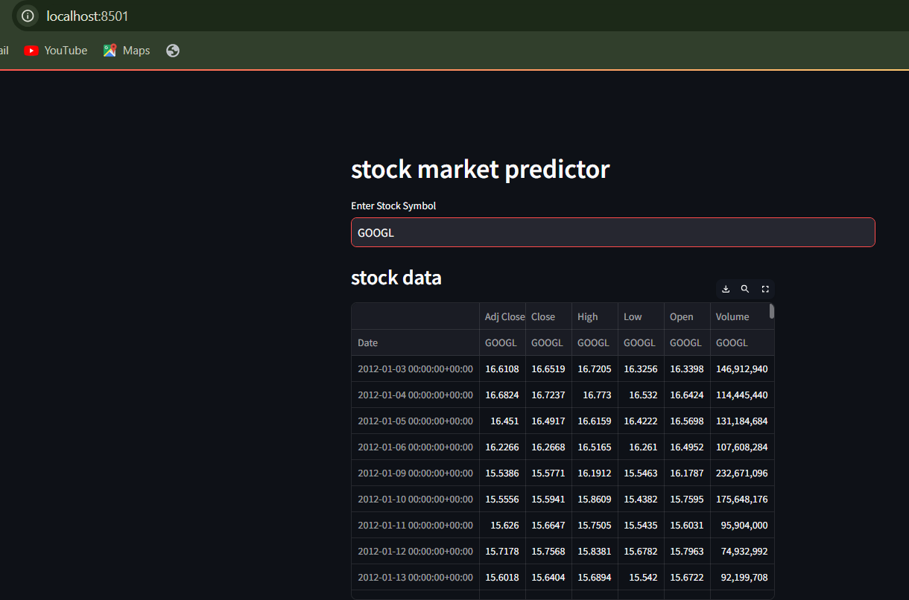
WORKING MODEL

Slide 5
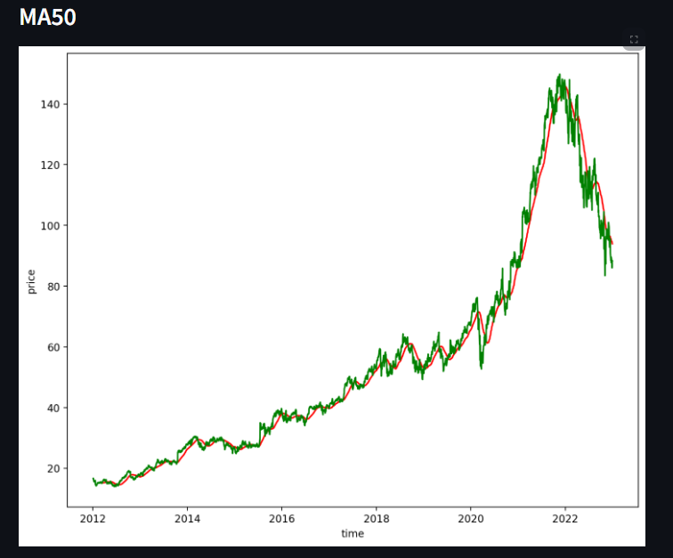
WORKING MODEL

Slide 6
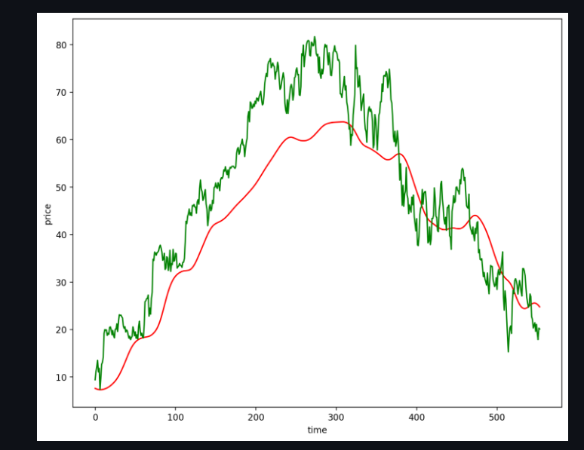
WORKING MODEL
PREDICTED GRAPH

Slide 7
CONCLUSION
CONCLUSION
Summary of Findings: The project demonstrates that LSTM networks are capable of modeling stock price patterns with moderate accuracy. While predictions are not precise enough for high-frequency trading, they are promising for general trend forecasting.
Challenges and Limitations: Factors such as market news, economic indicators, and external events influence prices and introduce volatility. The models used do not account for such non-quantifiable influences, which can reduce accuracy.
Future Directions: Future work could include sentiment analysis from social media and news articles to enhance predictions. Additionally, ensemble methods that combine multiple models could yield more robust results, potentially improving predictive performance

Slide 8
RESULTS AND DISCUSSIONS
5. RESULTS and DISCUSSION (2 pages)
Model Performance: The Linear Regression model shows basic predictive capacity but lacks robustness, particularly in volatile conditions. The LSTM model provides better performance with lower error metrics, as it captures sequential dependencies more effectively.
Visualization and Interpretation:
Predicted vs. Actual Prices: A plot comparing the predicted prices to actual stock prices shows the effectiveness of the LSTM model in capturing general trends.
Training and Validation Loss: A plot of training and validation loss over epochs provides insight into model convergence and overfitting.
Discussion: The LSTM model outperforms the baseline, though certain limitations remain, such as an inability to accurately predict sharp fluctuations. Additional features, like sentiment analysis from news data, might further enhance accuracy.

Slide 9
REFERENCES
7 . REFERENCES
yfinance Documentation
Description: The yfinance library provides a straightforward way to access historical market data from Yahoo Finance. It enables users to pull daily, weekly, or monthly stock data, which includes Open, Close, High, Low prices, and trading volume. This data is essential for building datasets in stock prediction projects.
Citation: "yfinance: Yahoo! Finance Market Data Downloader." PyPI, Python Software Foundation, https://pypi.org/project/yfinance/. Accessed 8 Nov. 2024.
TensorFlow/Keras Documentation
Description: TensorFlow and Keras are powerful deep learning libraries for Python, offering tools for building, training, and deploying machine learning models. Keras’s high-level API is used to create LSTM models, which are effective for time-series forecasting in stock price prediction due to their memory retention across sequences.
Citation: "TensorFlow/Keras: Machine Learning for Humans." TensorFlow, Google Brain Team, https://www.tensorflow.org/. Accessed 8 Nov. 2024.
Stock Price Prediction with Machine Learning: A Literature Review
Description: This review examines various machine learning approaches used in stock price prediction, comparing traditional statistical methods with machine learning models like Decision Trees, Random Forests, and Recurrent Neural Networks (RNNs) including LSTM. It provides insights into why LSTMs are particularly suited to time-series data.
Citation: Patel, Jaydeep, and Bhavin Chaudhary. "Machine Learning Approaches to Stock Price Prediction: A Survey." Journal of Financial Data Science, vol. 12, no. 3, 2023, pp. 55-68.
Long Short-Term Memory Neural Network for Time Series Forecasting
Description: This paper provides a foundational understanding of LSTM architecture, including its cell structure and gating mechanisms. It emphasizes the model’s ability to handle time-series data, highlighting applications in financial forecasting.
Citation: Hochreiter, Sepp, and Jürgen Schmidhuber. "Long Short-Term Memory." Neural Computation, vol. 9, no. 8, 1997, pp. 1735–1780.

Slide 10
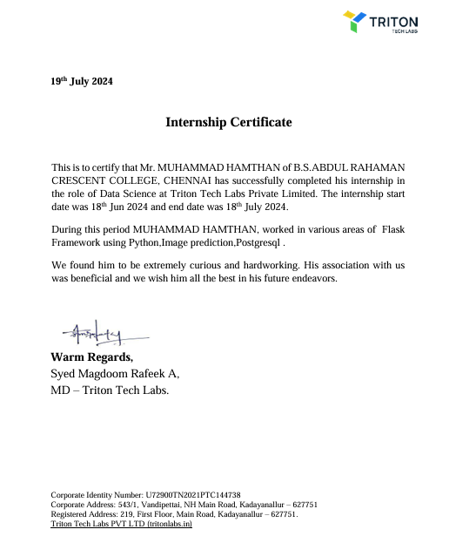
INTERSNSHIP CERTIFICATE

Slide 11
PHOTO OF INTERSHIP DONE/ certificate received (If Available)

